Slide 1
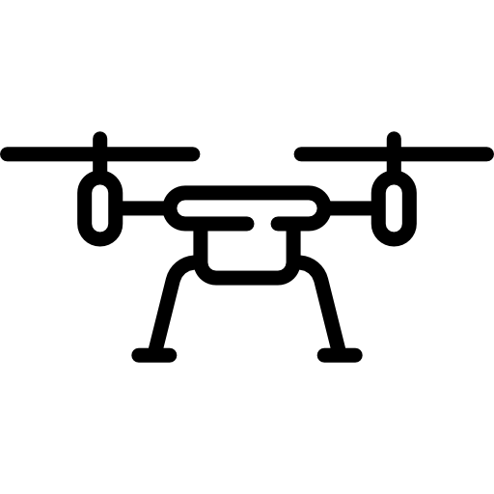



Handle Manual Control
Get video
Video stream
Handle Commands
Flight status
Manual control & Commands
Stream video
Display flight status
Get manual control & Commands

